Slide 1
Control Flow

Slide 2
Learning objectives
After completion of this topic, participants will be able to
Understand different programming constructs
Write programs using the constructs

Slide 3
Control Flow
Programs contains series of statements and that are executed by python top-down order.
If you want to change the flow of execution then we need to go for control flow statements
They are 3 control flow statements in python
if
for
while

Slide 4

if Statement
The ‘if’ statement is used to check a condition.
If the condition is true, we run a block of statements (if-block), else we process another block of statements (called else-block).
The else clause is optional.

Slide 5
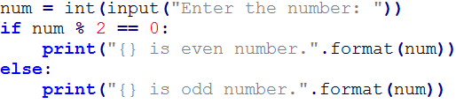
if-else Statement
The ‘if-else’ statement provides an else block combined with the ‘if’ statement which is executed in the false case of the condition.
If the condition is true, if-block executed. Otherwise else-block is executed.

Slide 6
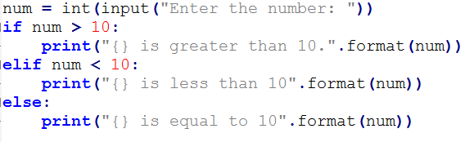
elif Statement
The ‘elif’ statement is used to check the multiple conditions and execute the specific block of statements depending upon the true condition among them.
We can have any number of ‘elif’ statements in our program depending upon our need, however using ‘elif’ is optional.

Slide 7
Short Hand if if-else and Multiple else Statements
short hand if
if (a > b): print(‘a is greater than b’)
short hand if-else
print(a) if (a> b) else print(b)
multiple 'else' statements in a single line
print(a) if a > b else print(b) if(c==d) else print(c)
logical ‘and’ and ‘or’ operations of if statements
if a > b and c == d:
print(‘Inside if statement’)

Slide 8
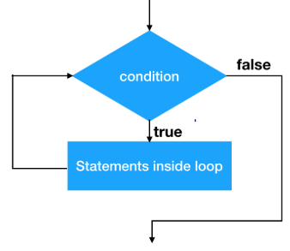
Python Loops
By default in any programming language, flow of execution is sequential.
Sometimes you may require to change flow and repeat the execution of specific code. In that case we can go for loops provided by programming languages.

Slide 9
activities
Check whether a given string is palindrome or not. (Hint: a word, phrase, or sequence that reads the same backwards as forwards) Ex:madam – 15 mins
Write a program to check given year is leap year. Year should be divisible by 4, 400 and 100 – - 15 mins
Write a program to input two strings. If two strings have the same length, then the function should print all strings line by line. – 15 mins
Write a program to check whether a given number is odd or even. – 15 mins
Write a program to find the biggest number among three numbers. – 15 mins

Slide 10
Types of Loops
Loop Statement | Description
for loop | The for loop is used in the case where we need to execute some part of the code until the given condition is satisfied. It is better to use ‘for’ loop if the number of iteration is known in advance.
while loop | The while loop is to be used in the scenario where we don't know the number of iterations in advance. The block of statements is executed in the while loop until the condition specified in the while loop is satisfied.
do-while loop | The do-while loop continues until a given condition satisfies. It is used when it is necessary to execute the loop at least once.

Slide 11


‘for’ Loop
‘for’ loop is used for iterating over a sequence. i.e., list, tuple, dictionary, set or string.
# Loop through a list
# Loop through a string

Slide 12
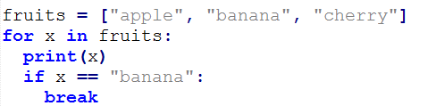

‘for’ Loop
# ‘break’ Statement
# ‘continue’ statement

Slide 13
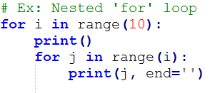
Nested for Loop
Python allows us to nest any number of ‘for’ loops inside ‘for’ loop.
The inner loop is executed ‘n’ number of times for every iteration of the outer loop.
Example for ‘nested for’ loop.

Slide 14
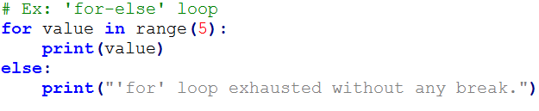
‘for-else’ Loop
Python allows us to use the ‘else’ statement with the for loop, which can be executed only when all the iterations are exhausted.
Note: If the ‘for’ loop contains any ‘break’ statement then the ‘else’ statement will not be executed.
Ex:

Slide 15
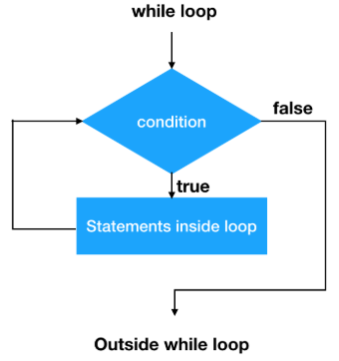

while Loop
While loop is also known as pre-tested loop.
In general, while loop allows a part of the code to be executed as long as the given condition is true.
The while loop is mostly used in the case where the number of iterations are not known in advance

Slide 16
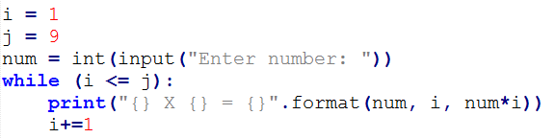
while Loop
Example:

Slide 17
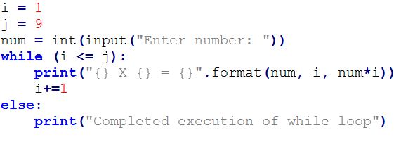
while loop with ‘else’ block
‘else’ block executed when condition of while loop is false.
Note: if the while loop is broken using break statement, then the else block will not be executed and the statement present after else block will be executed

Slide 18
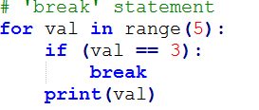
break statement
‘break’ is a keyword in python which is used to bring the program control out of the loop.
In case of nested loops, it breaks the inner loop first then proceeds to the outer loops.
The break is commonly used in the cases where we need to break the loop for a given condition.
Syntax
break

Slide 19
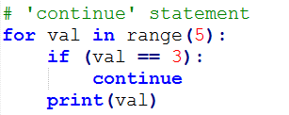
Continue statement
‘continue statement in python is used to bring the program control to the beginning of the loop.
The ‘continue’ statement skips the remaining lines of the code inside the loop and start with the next iteration.
Syntax : continue
Example:

Slide 20
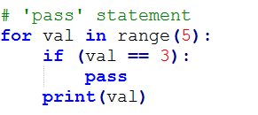
pass Statement
The pass statement is a null operation. Nothing happens when it executed.
It is used in the cases where a statement is syntactically needed but we don’t want to use any executable statement at its place.
Example

Slide 21
activities
1. Write a program to print below pattern – 15 mins
*
**
***
****
*****
******
*******
2. Write a program to find the factorial of a given number – 30 mins
3. Write a program which will find all such numbers which are divisible by 7 but are not a multiple of 5,
between 2000 and 3200 (both included). - 30 mins
4. Find the sum of ½ + 2/3 + ¾+4/5+6/7+…n terms. - 30 mins

Slide 22
activities
Generate prime numbers between 1 to 100. - 30 mins
Check whether a given number is Armstrong or not. - 30 mins
Generate squares of numbers from 1 to 50 - 20 mins
Write a program to find Greatest common divisor for any two given numbers. - 45 mins
Generate multiplication table for the given number. -15 mins
Write a program to extract vowels from a given string. – 20 mins

Slide 23
activities
11. Write a program to generate the following pattern
121
12321
1234321
123454321
12345654321
1234567654321

Slide 24
activities
12. Write a program to generate the following pattern.
*2*
*232*
*23432*
*2345432*
*234565432*
*23456765432*

Slide 25
references
https://docs.python.org/3/tutorial/

